Slide 1
red is sus, kinda (RISK)
Team m o v e n d o
Toby Frank, Raffa Gonzalez, Khaya Kingston, James Lucassen

Slide 2
Motivation
College students are prone to spreading COVID, since self-isolation often conflicts with academic or social priorities
Even with responsible intentions, lapses of judgement or willpower will still happen
To make a campus of students safe, we need a system to reinforce social distancing norms and enable students to overcome those lapses

Slide 3
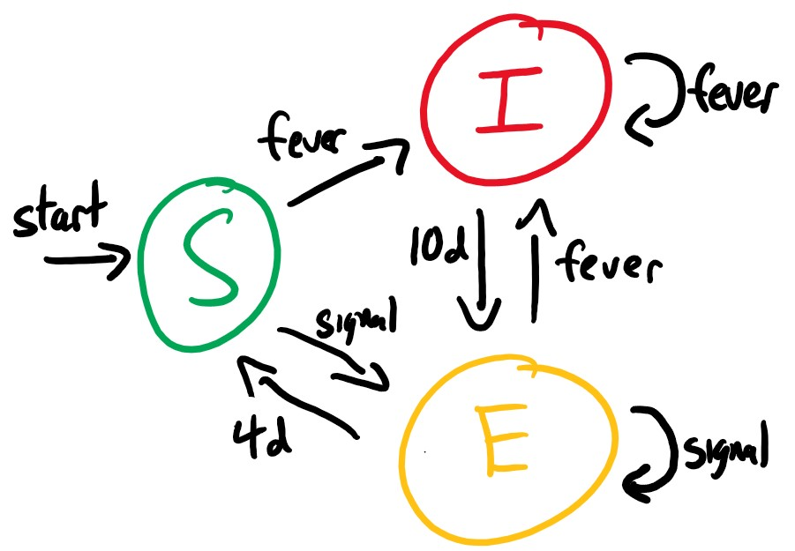
Solution
The RISK system is a mask attachment
Temperature sensor, color indicator, transmitter/receiver, microprocessor and battery
Tracks and displays risk status to create peer norms
Creates a precise safety standard

Slide 4
Simulation
Used a Python simulation to construct a model of students interacting on campus
Each individual risk is tracked using only information available to RISK units
By communicating to nearby individuals, proper avoidance can dramatically decrease spread
Model uses a population with negligible density of non-RISK units, which makes the product uniquely well-suited for universities

